Slide 1

Estimated Project Schedule
LCO Artifacts Due – 03/12/2012
LCO Presentation Slides Due – 03/16/2012
LCO milestone – 03/20/2012
Project Iteration Briefing – 05/01/2012

Slide 2
Project Overview
Scope:
  This project will provide a tracking mechanism for the University of South Alabama's transportation system, the JagTran.
  This will give students a way to track the bus, plan out their schedule, and know when to get to a bus stop.

Slide 3
Project Overview
Vision

Slide 4
High Level Candidate Architecture
All data storage will be done via SQL database
Bus locations can be obtained via GPS sensors
Student's boarding/exiting the bus can be done in multiple ways:
  Motion sensor on the bus
  Interact with application

Slide 5
High Level Candidate Architecture
Route times will be estimated and averaged

Slide 6
Recommendations on components to buy/build/reuse
GPS sensors ($40 - $200)
Possibly motion sensors ($20 - $300)

Slide 7
Development Case
Major RUP changes:
  Reports were omitted, unneeded due to team size and length constraints
  Audits were omitted for same reasons
Has rough artifact deadline information
Has team information

Slide 8
Plans for Prototypes/Demos
One UI Prototype will be ready by the first LCO phase deadline
For the second iteration, research will into OODBMS will be done
At the end of the second iteration, a demo for accessing the database should be done

Slide 9
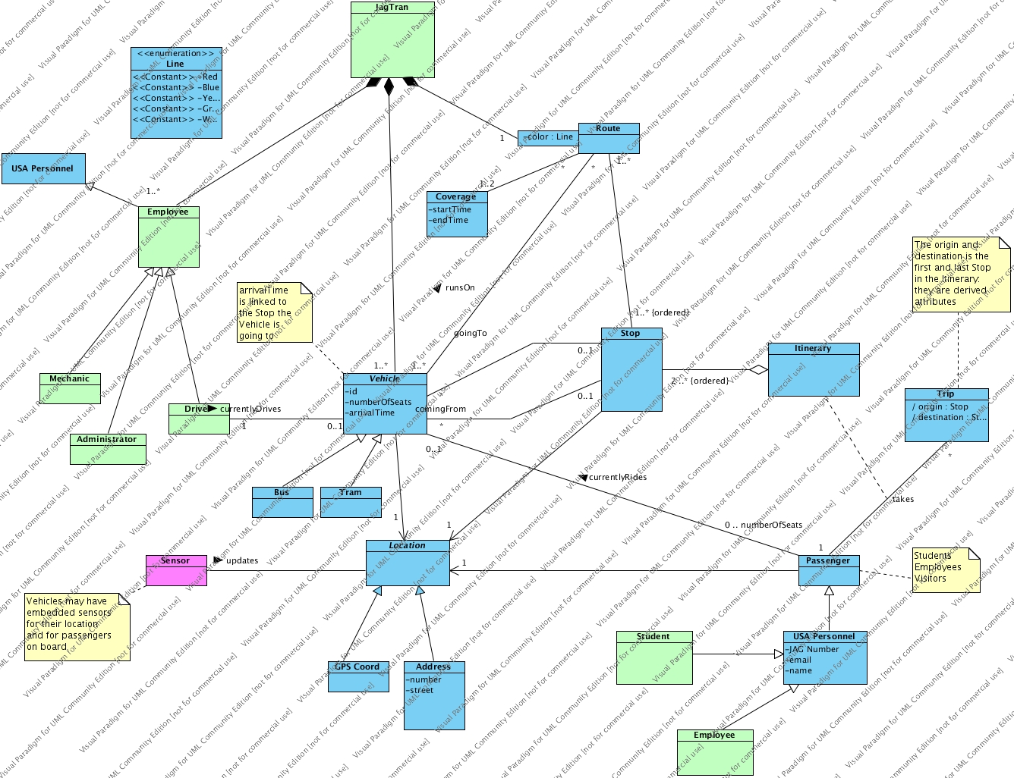
Initial Domain Model

